Slide 1
Action in a dynamic environment
Translational Neuromodelling
1.6.18
Jasmine Belfrage, Ignacio Iturralde, Marcel Graetz

Slide 2
Presentations
Social anxiety
rejection
Workload
Illnesses

Slide 3
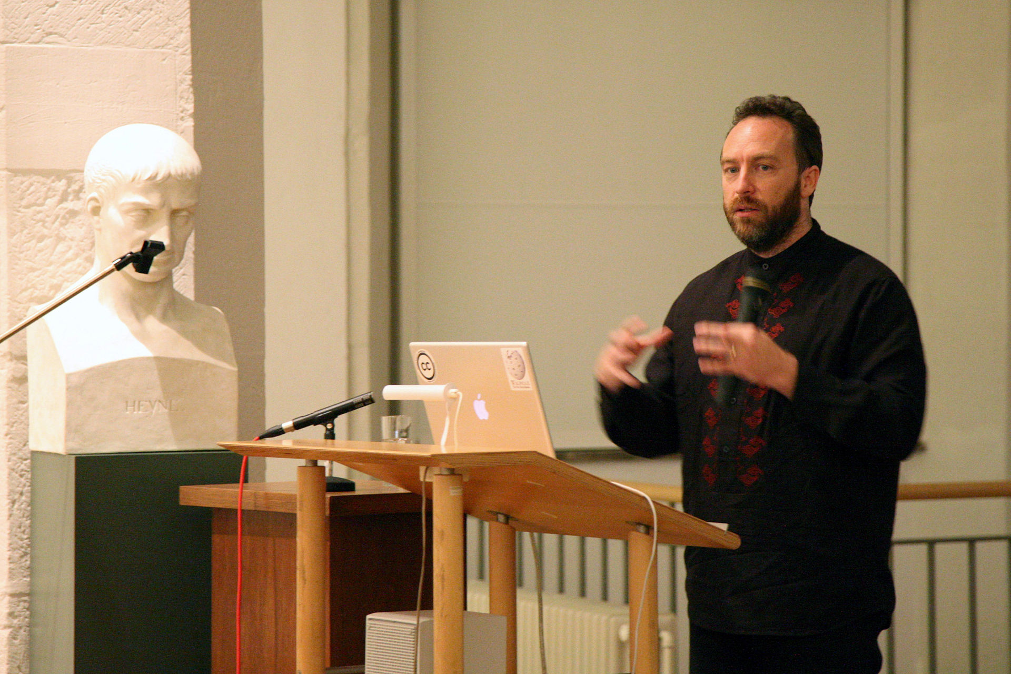
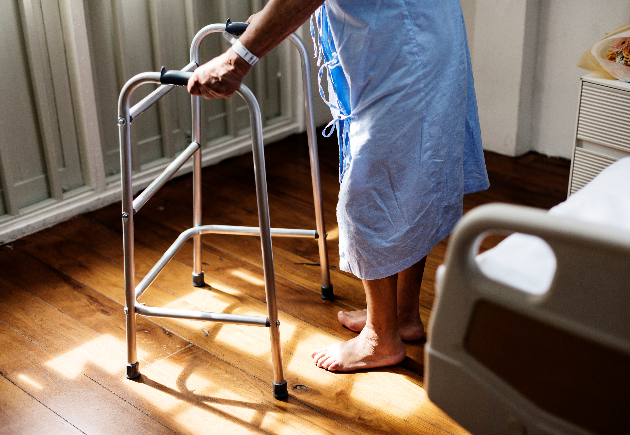


Idea

Slide 4
Aim
agent
internal model
desired state
noisy input
action/control
environment
variable of interest
external factors
Notes:
Modelling potential behavior of an agent trying to control the environment
Simulation
No actual data (yet)
Trying to control a dynamic environment.
How could we model that?

Slide 5
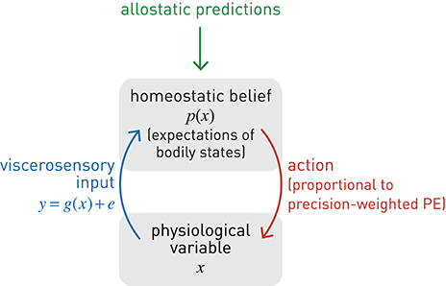
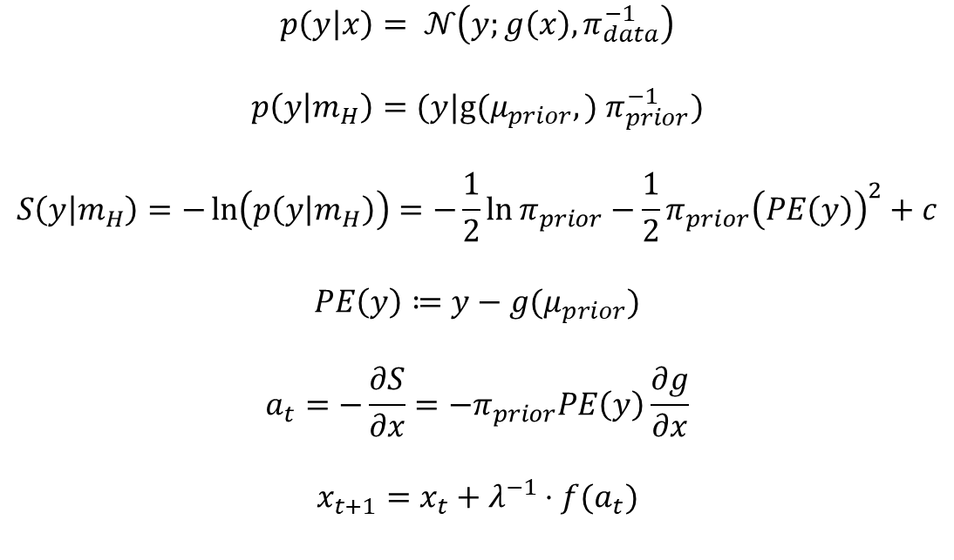
Allostatic control
$$p\left(y | x\right)= 𝒩\left(y;g\left(x\right), π_{data}^{−1}\right)$$
$$p\left(y | m_{H}\right)=(y|\text{g}\text{(}μ_{prior},) π_{prior}^{−1})$$
$$S\left(y | m_{H}\right)=−\ln\left(p\left(y | m_{H}\right)\right)=−\frac{1}{2}\ln{π_{prior}−\frac{1}{2}π_{prior}{\left(PE\left(y\right)\right)}^{2}}+c$$
$$PE\left(y\right)≔y−g(μ_{prior})$$
$$a_{t}=−\frac{∂S}{∂x}=−π_{prior}PE\left(y\right)\frac{∂g}{∂x}$$
$$x_{t+1}=x_{t}+{λ^{−1}⋅f(a}_{t})$$
Stephan et al. 2016, Front. Hum. Neurosci
Notes:
Action is purely based on perception.
Tries to minimize surprise on new input.

Slide 6

Problems
agent
desired state
$$≈$$
noisy input
action/control
environment
variable of interest
external factors
Stephan et al. 2016, Front. Hum. Neurosci

Slide 7
Problems
agent
internal model
desired state
noisy input
action/control
environment
variable of interest
external factors
Notes:
Modelling potential behavior of an agent trying to control the environment
Simulation
No actual data (yet)
Trying to control a dynamic environment.
How could we model that?

Slide 8
Problems in allostatic control
Action is based only on the input
No model of the world
(equation: no precision of model, only of desire)
=> reacting to sensory noise (image!)

Slide 9
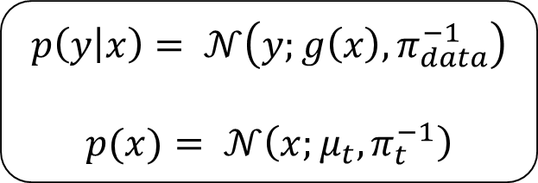
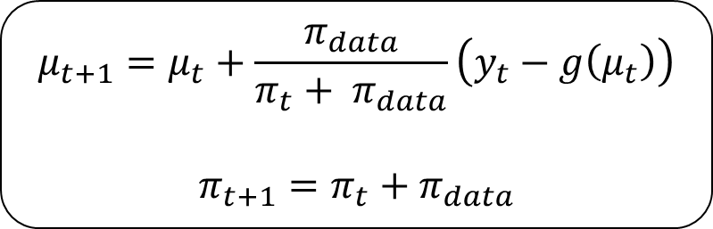
Simple perceptual inference
$$p\left(y | x\right)= 𝒩\left(y;g\left(x\right), π_{data}^{−1}\right)$$
$$p(x)= 𝒩\left(x;μ_{t}, π_{t}^{−1}\right)$$
Update equations
$$μ_{t+1}=μ_{t}+\frac{π_{data}}{π_{t}+ π_{data}}\left(y_{t}−g\left(μ_{t}\right)\right)$$
$$π_{t+1}=π_{t}+π_{data}$$

Slide 10
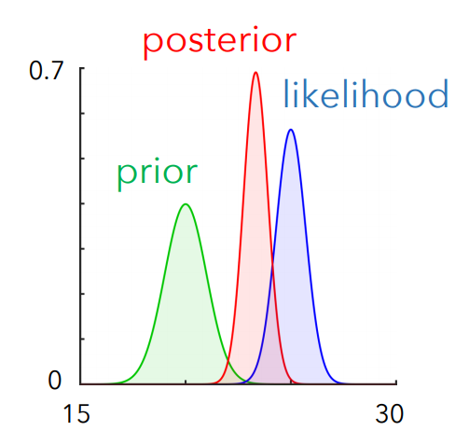
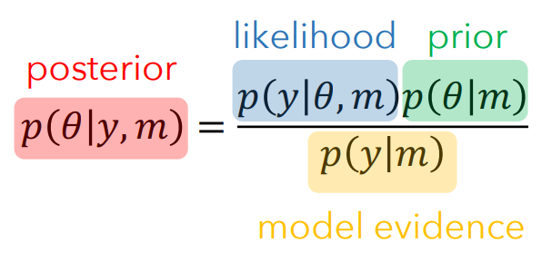
Problems
agent
internal model
$$≈$$
noisy input
environment
variable of interest
Illustration from Stefan Frässle

Slide 11
First solution
agent
internal model
desired state
noisy input
noisy input
action/control
environment
variable of interest
external factors

Slide 12
Problems with this kind of learning
Only adaptive for stable environments
Precision of prior belief increases monotonically
Not adaptive if environment changes

Slide 13
In need for a better framework…

Slide 14
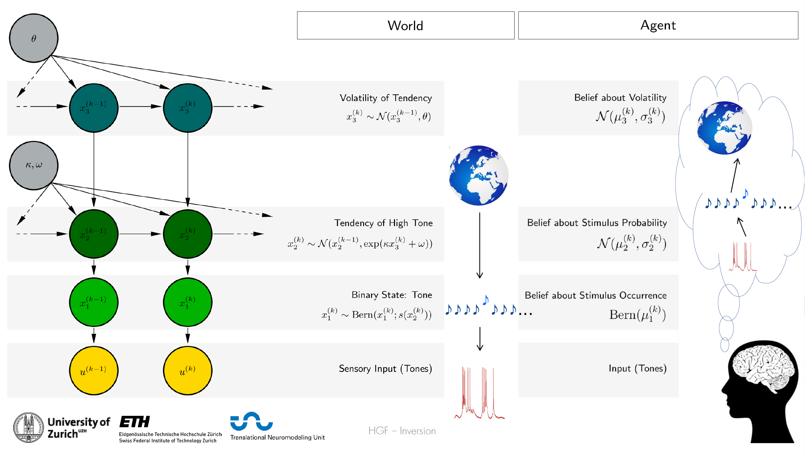

Slide 15
Advantage
agent
internal model
HGF
$$≈$$
noisy input
environment
variable of interest
external factors

Slide 16
Reminder
agent
internal model
$$≈$$
noisy input
environment
variable of interest
Illustration from Stefan Frässle

Slide 18
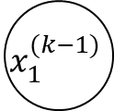
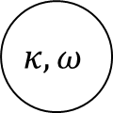
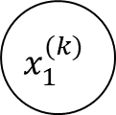
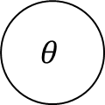
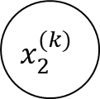
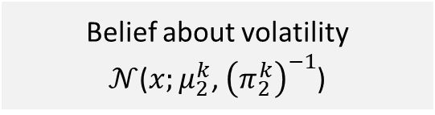
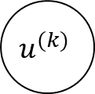
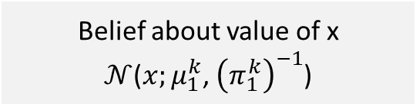
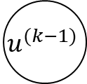
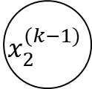
In our case:
$$θ$$
$$x_{2}^{(k−1)}$$
$$x_{2}^{(k)}$$
Belief about volatility
$𝒩$($x;μ_{2}^{k}$, ${\left(π_{2}^{k}\right)}^{−1}$)
$$κ, ω$$
$$x_{1}^{(k−1)}$$
$$x_{1}^{(k)}$$
Belief about value of x
$𝒩$($x;μ_{1}^{k}$, ${\left(π_{1}^{k}\right)}^{−1}$)
$$u^{(k−1)}$$
$$u^{(k)}$$

Slide 19
Implementing action
agent
internal model
desired state
noisy input
action/control
environment
variable of interest
external factors
Notes:
Modelling potential behavior of an agent trying to control the environment
Simulation
No actual data (yet)
Trying to control a dynamic environment.
How could we model that?

Slide 20
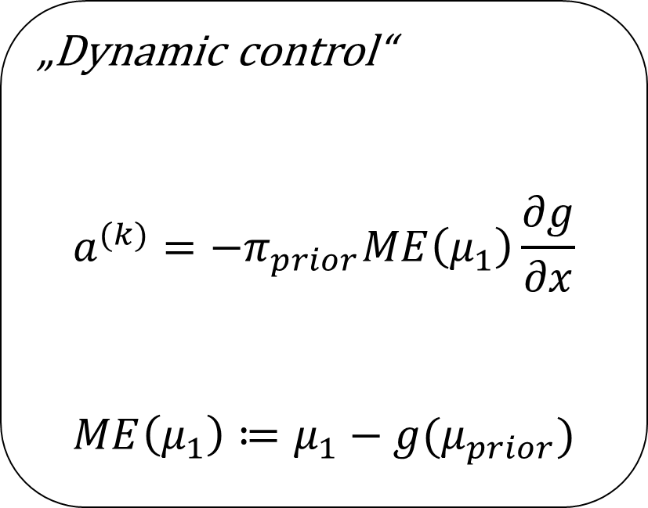
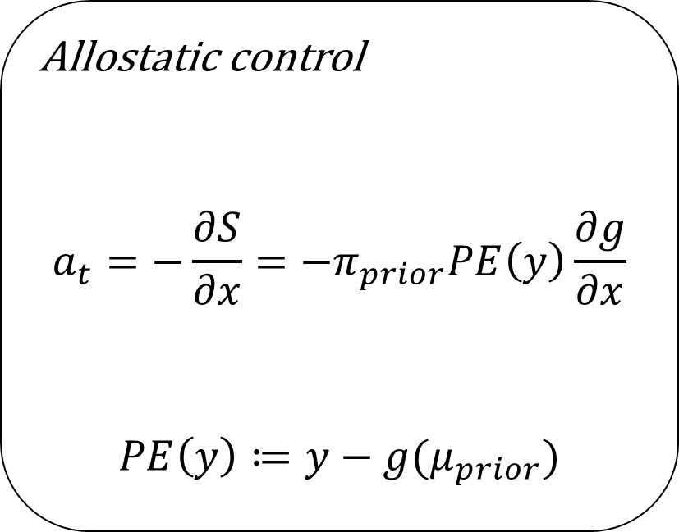
Implementing action
Allostatic control
$$a_{t}=−\frac{∂S}{∂x}=−π_{prior}PE\left(y\right)\frac{∂g}{∂x}$$
$$PE\left(y\right)≔y−g(μ_{prior})$$
„Dynamic control“
$$a^{(k)}=−π_{prior}ME\left(μ_{1}\right)\frac{∂g}{∂x}$$
$$ME\left(μ_{1}\right)≔μ_{1}−g(μ_{prior})$$

Slide 21
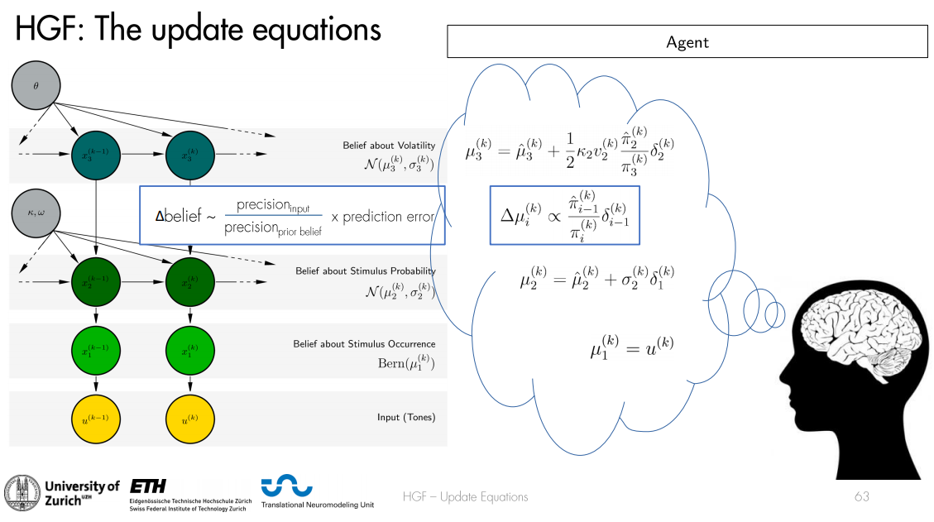

Slide 22
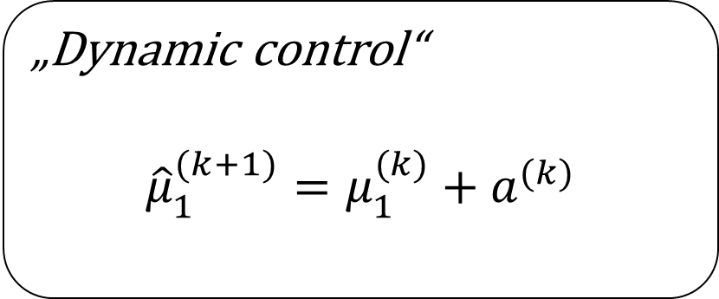
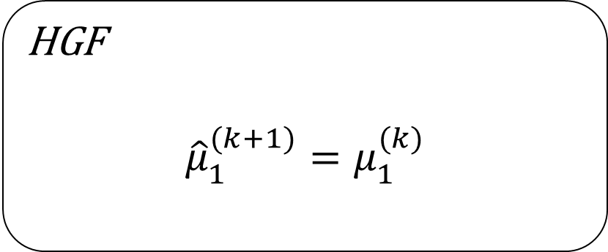
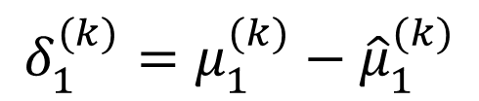
Implementing action
A good agent knows about her actions!
$$δ_{1}^{(k)}=μ_{1}^{(k)}−{\hat{μ}}_{1}^{(k)}$$
HGF
$${\hat{μ}}_{1}^{(k+1)}=μ_{1}^{(k)}$$
„Dynamic control“
$${\hat{μ}}_{1}^{(k+1)}=μ_{1}^{(k)}+a^{(k)}$$

Slide 23

A good agent knows about her actions.
Before: ${\hat{μ}}_{k+1}^{(1)}=μ_{k}^{1}$
Now: ${\hat{μ}}_{k+1}^{(1)}=μ_{k}^{1}+a_{k}$
Problem: This is not an inverted generative model anymore.
But still: works

Slide 24
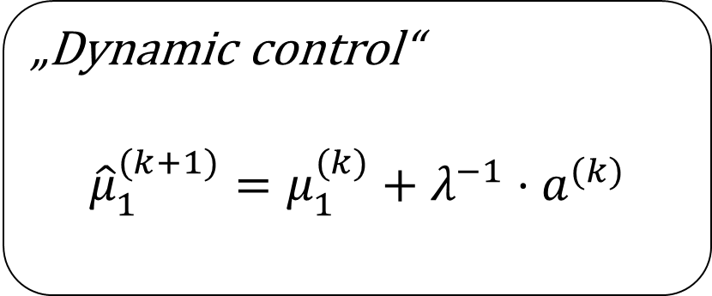
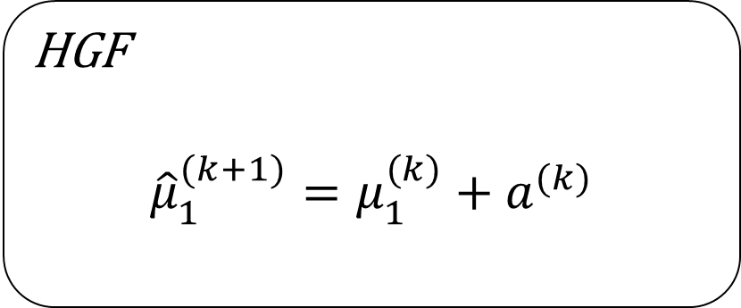
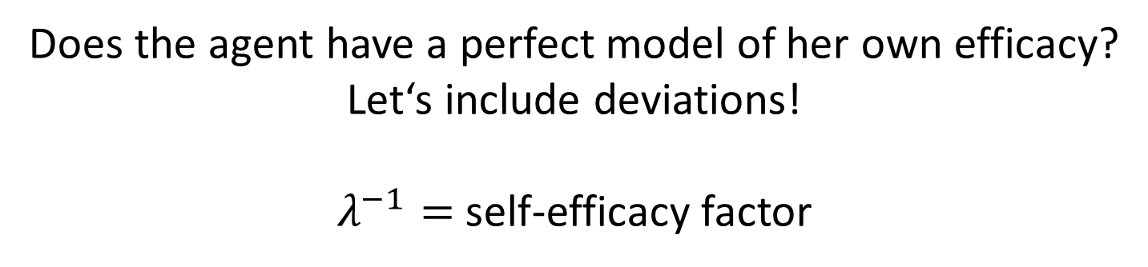
Beliefs about effect of actions
Does the agent have a perfect model of her own efficacy?
Let‘s include deviations!
$λ^{−1}=$ self-efficacy factor
HGF
$${\hat{μ}}_{1}^{(k+1)}=μ_{1}^{(k)}+a^{(k)}$$
„Dynamic control“
$${\hat{μ}}_{1}^{(k+1)}=μ_{1}^{(k)}+{λ^{−1}⋅a}^{(k)}$$

Slide 25

What effect do my actions have?
How to bring in confidence?
Before: ${\hat{μ}}_{k+1}^{(1)}=μ_{k}^{1}$
Now: ${\hat{μ}}_{k+1}^{(1)}=μ_{k}^{1}+a_{k}$
And now: ${\hat{μ}}_{k+1}^{(1)}=μ_{k}^{1}+{λ^{−1}⋅a}_{k}$
$λ^{−1}$ is the confidence score!

Slide 26
Demo

Slide 27
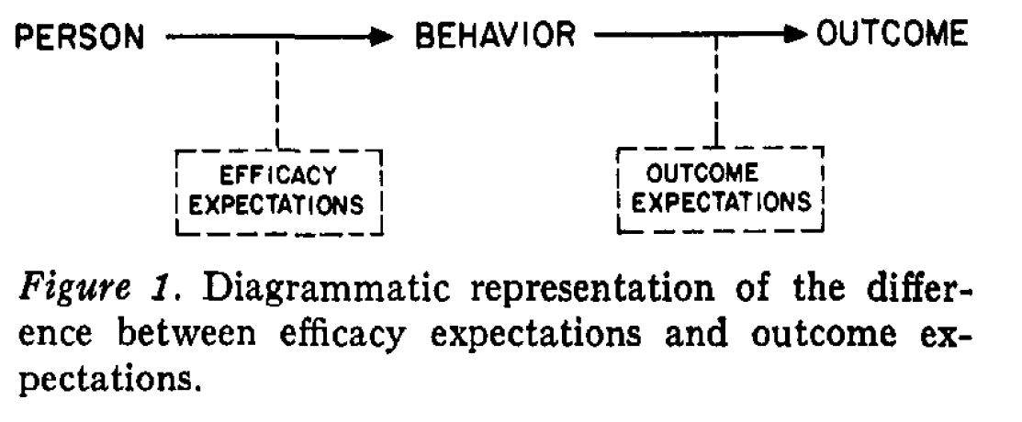
Application
Depression
Social anxiety
Narcissism
Cave!
Would you act if you did not think it were effective?
Source: Bandura, 1977
Notes:
=> more generally: deviations from “standard” self-efficacy feeling

Slide 28
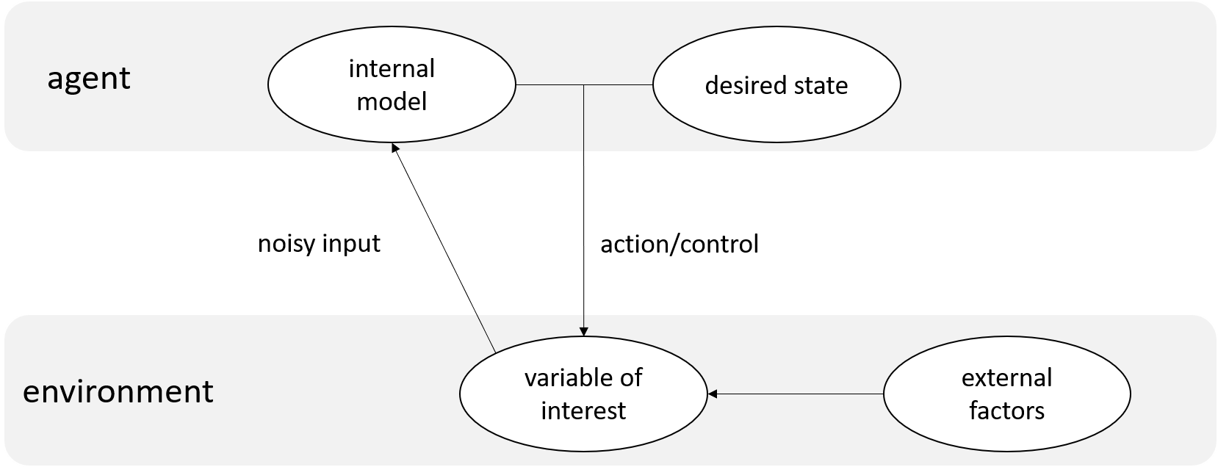

Strengths of our approach
functionality of HGF $⇒$ more options to be tried out

Slide 29
Weaknesses of our approach
Not a generative model anymore.
Loss of one of the core strengths of HGF!
But in principle, this model is invertible, right?
Notes:
One weakness of the HGF: random walks?
Real models need more and more and more layers

Slide 30
What would have been next?
Test predictive validity.
Modelling actual data…
…
Build and invert a generative model.
Notes:
Self-efficacy ratings on a simple task
Compare performance to model

Slide 31
What about these problems?
How does the brain build those models?
We must have to capacity to build many of those models at once and also compare them.
How?

Slide 32
Sources
Jimmy Wales during his lecture at the Paulinerkirche, Göttingen
Lecture slides

